Slide 1

Tic-Tac-Toe Game Implementation on Android

Slide 2

TEAM MEMBERS
 | Name | Student ID
1. | Amanjot Kaur Ahluwalia | 40011623
2. | Arash Arasteh | 40000580
3. | Arash Farkish | 27678835
4. | Basireddy Sandeep Kumar | 40016071
5. | Dalvir Singh Bains | 40012722
6. | Nidhi Arora | 40014504
7. | Parinaz Barakhshan | 27675518
8. | Sarthak Batra | 27408978
Triple-T Team

Slide 3
Presentation Outline
Project Requirements
Architectural pattern
Design pattern
Implementation(Heuristic)
Screenshots of Application

Slide 4

Requirements
1

Slide 5
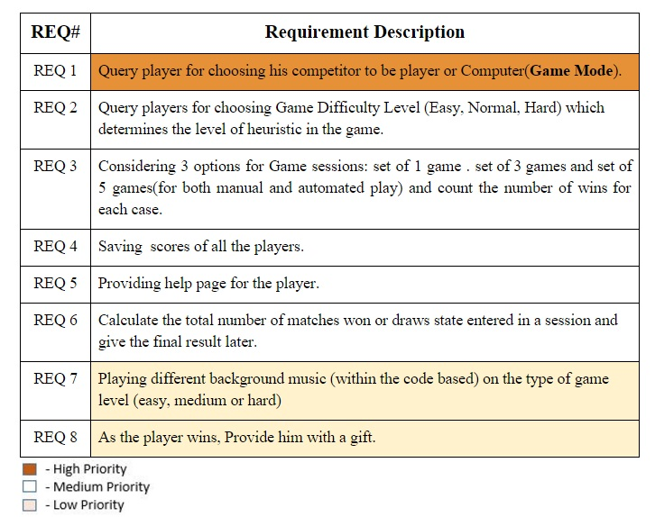

Slide 6
Extra Features

Slide 7
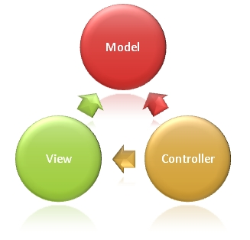
Architectural Pattern
2

Slide 8
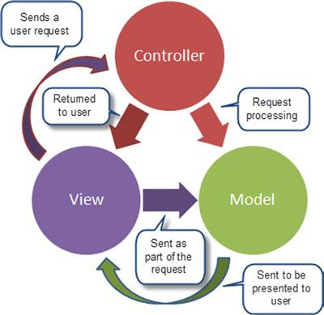
Model-View-Controller
MVC pattern
The model directly manages the data, logic and rules of the Game.
the view can be any output representation of information, such as GUI.
the controller, accepts input and converts it to commands for the model or view.

Slide 9

Design Patterns
3

Slide 10

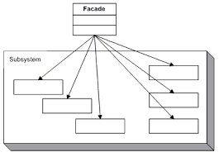
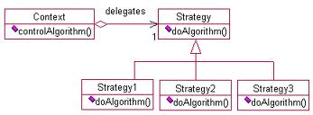
Design Pattern
Façade in Deliverable 1
Strategy in Deliverable 3
Façade?
Strategy??
Observer???

Slide 11

Implementation
4

Slide 12
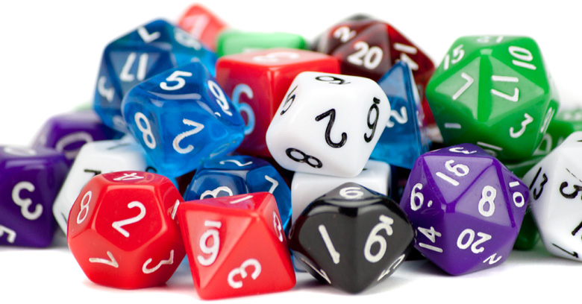
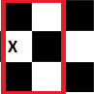
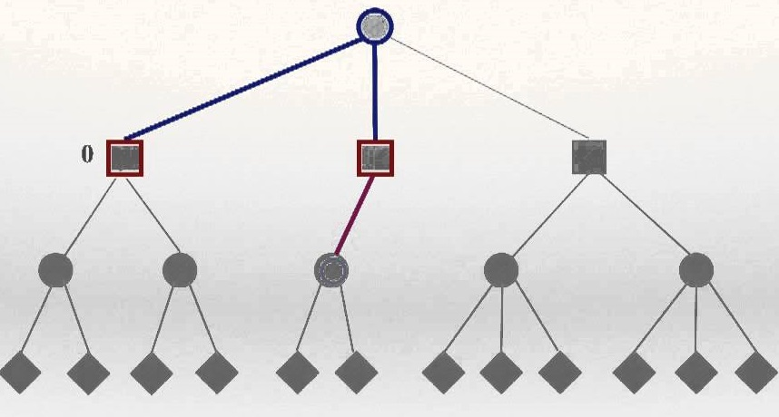
Three Difficulty Levels
EASY
random()
MEDIUM
locating any available position around the grid square that was just marked
HARD
minimax algorithm

Slide 13
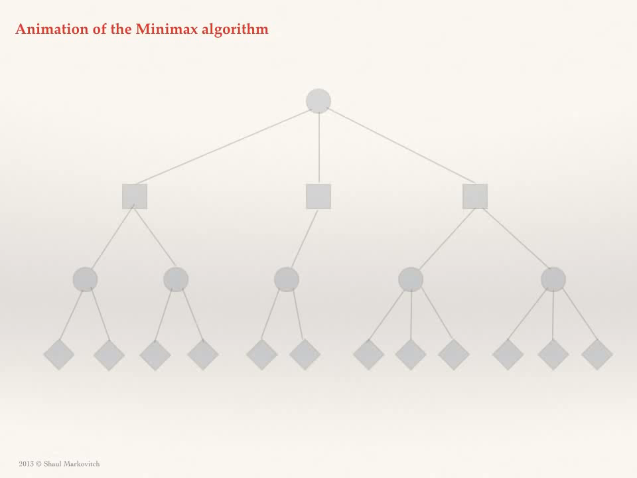
Heuristic

Slide 14

Demo
5

Slide 15

6
Experience

Slide 16
THANK YOU
ANY QUESTIONS?????

